Slide 1


Macroeconomics
lecture 08: the basis of international trade
Dr. Hemantha Premarathne,
Department of Social Sciences,
KDU
B.A. Econ & Stat (Hons) Pera, M.A. & Ph.D. (Saga, Japan)

Slide 2
Layout of the Lecture
  8.1 Define International Trade
  8.2 Why do People and Nations Engage in International Trade
  8.3 Measuring Gains from Trade
Cont…

Slide 3
  8.1 Definition of International Trade
International trade is the exchange of capital, goods, and services across international borders or territories. In most countries, such trade represents a significant share of Gross Domestic Product (GDP).

Slide 4
Gains from International Trade using PPC

Slide 5
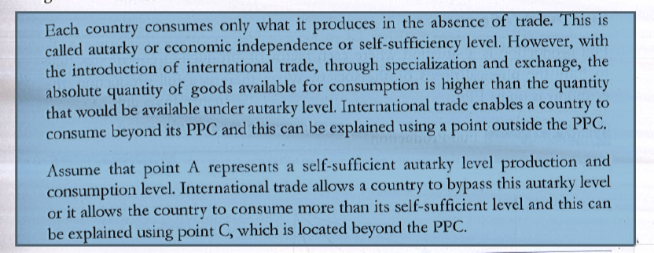
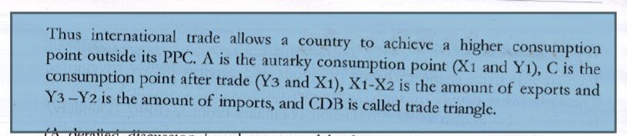

Slide 6
Theories of Trade and Economic Development

Slide 7
Evolution of Trade Theories
Mercantilism
Absolute Advantage (Classical)
Comparative Advantage
Factor Endowment Theory
International Product Cycle
National Competitive Advantage

Slide 8
Mercantilism
Mercantilism suggests that it is in a country’s best interest to maintain a trade surplus -- to export more than it imports
Countries conducted trade in exchange of gold and silver in the mid 16th century in England.
A country could earn gold and silver by exporting, thereby increasing their gold and silver reserve-an increase in national wealth, prestige and power.
The contrary takes place when a country imports.

Slide 9
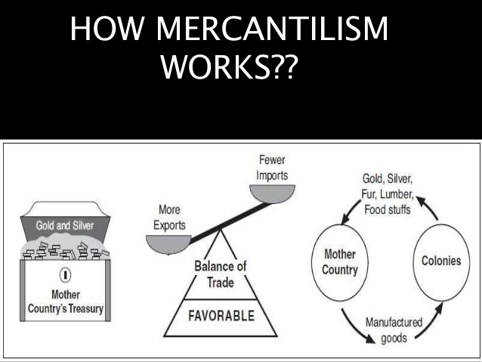

Slide 10
Mercantilism
So, this theory advocated government intervention to achieve a surplus in the balance of trade.
The policy was to maximize exports and minimize imports-imports were limited by tariffs & quotas, while exports were subsidized.
This theory is however criticized because trade surplus increase money supply in a country. An increase in money supply raises the demand and consequently the price of goods. The result of this is inflation.
Notes:
In the long run, no country can sustain a surplus on the balance of trade.

Slide 11
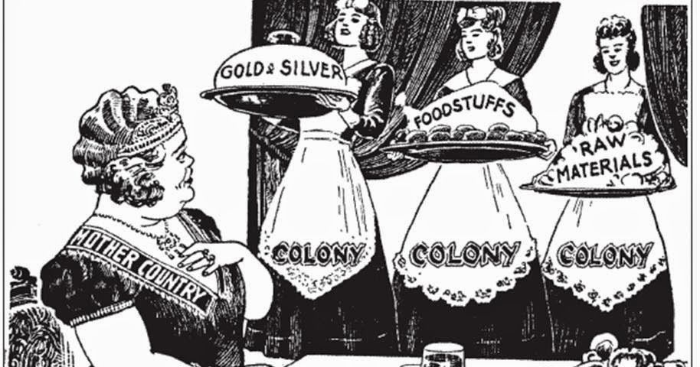
Mercantilism
It views trade as a zero-sum game, one in which a gain by one country results in a loss by another, rather than a positive-sum game, a situation where all countries in trade can benefit.

Slide 12
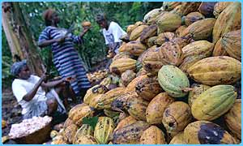
Theory of Absolute Advantage
Adam Smith: Wealth of Nations (1776) argued:
A country that has an absolute advantage produces greater output of a good or service than other countries using the same amount of resources.
    refers to a country’s ability to produce a certain good more efficiently than another country
    A country should produce only goods where it is most efficient, and trade for those goods where it is not efficient
Trade between countries is, therefore, beneficial

Slide 13
QUESTIONS
Total resources available to each country is 200 units.
Resources required to produce 1 ton of each product are as follows:
Q:1. Which country has an absolute advantage, and in which product? Justify and explain.
Country | Biscuits | Wheat
India | 20 | 10
China | 40 | 50

Slide 14
Problem with Absolute Advantage.
According to the absolute advantage theory, international trade is a positive-sum game, because there are gains for both countries to an exchange.
If there is one country that does not have an absolute advantage in the production of any product, will there still be benefit to trade, and will trade even occur?
The answer may be found in the extension of absolute advantage, the theory of comparative advantage.

Slide 15
Theory of comparative advantage
David Ricardo: Principles of Political Economy (1817)
  The principle of comparative advantage states that a country should specialize in producing and exporting those products in which is has a comparative, or relative cost, advantage compared with other countries and should import those goods in which it has a comparative disadvantage.
  the exporting country should look at the relative efficiencies of production for both commodities and make only those goods it could produce most efficiently.
  Law of comparative advantage refers to the ability of a country to produce a particular good or service at a lower opportunity cost (loss of potential gain from other alternatives when one alternative is chosen) than another country.

Slide 16
Example:
Think of the following scenario:
If all of the resources of the two countries were fully
allocated, this is what they could produce.
Food Fish
Bangladesh 100 tones 100 tones
Nepal 400 tones 200 tones
Who has the absolute advantage and what is the comparative advantage? Look at the opportunity costs.
http://en.wikipedia.org/wiki/Comparative_advantage

Slide 17
How to Calculate Opportunity Cost:
Select one alternative
Divide what you are losing by what you gain from choosing that alternative.
For example, if Nepal chooses to produce food, the opportunity cost is:
200 = 0.5
400
Nepal loses 0.5 tonnes of fish for every tonne of food they produce.

Slide 18
Conversely, if Nepal decides to produce fish, the opportunity cost would be:
400 = 2
200
Nepal loses 2 tonnes of food to produce 1 tonne of fish.

Slide 19
Answers:
With full employment of all resources, Nepal has the absolute advantage of producing both goods.
But… when comparing opportunity costs:
Bangladesh's opportunity cost of producing 1 tone of food is 1 tone of fish (vice versa)
Nepal's opportunity cost of producing 1 tone of food is 0.5 tones of fish.
Nepal's opportunity cost of producing 1 tone of fish is 2 tones of food.

Slide 20
Therefore, Nepal has the comparative advantage in food production, and Bangladesh has the comparative advantage in fish production.
Both countries are better trade-off if Nepal produces food to trade for Bangladesh's fish.

Slide 21
WEAKNESSES OF EARLY THEORIES
the theories incorrectly assumed:
The existence of perfect knowledge regarding international markets and opportunities
Full mobility of labor and production factors throughout each country
Full labor employment within each country
The theory also assumed that each country had as its objective full production efficiency.
Overly simplistic in that it deals with only two commodities and two countries.
The largest area of weakness in classical theory is that while we considered all resource units used in production, the only costs considered by classical economists were those associated with labor. The theorists did not account for other resources used in the production of commodities or manufactured goods for export, such as transportation costs, the use of land, and capital.

Slide 22
Heckscher-Ohlin Theory
FACTOR ENDOWMENT THEORY
The countries differ with respect to the availability of the factors of production.
They differ if one country, for example, has many machines (capital) but few workers, while another country has a lot of workers but few machines.
According to the Heckscher-Ohlin theory, a country specializes in the production of goods that it is particularly suited to produce.
Capital Intensive
Labour Intensive

Slide 23



Machines and Workers
The production of goods and services requires capital and workers. Some goods require more capital - technical equipment and machinery - and are called capital intensive. Examples of these goods are cars, computers, and cell phones.
Other goods require less equipment to produce and rely mostly on the efforts of the workers. These goods are called labor intensive. Examples of these goods are shoes and textile products such as jeans.

Slide 24
MODERN THEORIES
INTERNATIONAL PRODUCT LIFE
CYCLE THEORY (IPLC)
The product life-cycle theory is an economic theory that was developed by Raymond Vernon.
The intent of his International Product Life Cycle model (IPLC) was to advance trade theory beyond David Ricardo’s static framework of comparative advantages.
The product life cycle - explain how trade patterns change overtime.
This theory looks at the potential export possibilities of a product in four discrete stages in its life cycle.

Slide 25
Stage 1: Introduction
New products are introduced to meet local (i.e., national) needs, and new products are first exported to similar countries, countries with similar needs, preferences, and incomes.
In this stage, the company generally has little competition in its markets abroad.

Slide 26
Stage 2: Growth
Increase in sale of new product attracts competitors.
Unfortunately, so does competition as other firms enter the arena and the product becomes increasingly standardized.
Further innovation in product, cost reduction, market process takes place (technical equipped)
Solution
Shift manufacturing to foreign countries
(E.g., the IBM PCs were produced in the US and spread quickly throughout the industrialized countries.)

Slide 27
Stage 3: Maturity
Exports from the home country decrease because of increased production in overseas locations.
At this point, price becomes a crucial determinant of competitiveness. Consequently, minimizing costs becomes an important objective of the manufacturing firm.
Production also frequently shifts from being within foreign industrial markets to less costly less-developed countries (LDCs) to take advantage of cheaper production factors, especially low labor costs.
At this point the innovator country may even decide to discontinue all domestic production, produce only in third world countries, and re export the product back to the home country and to other markets.

Slide 28
Stage 4: Decline
The product enters a period of decline.
This decline is often because new competitors have achieved levels of production high enough to effect scale economies that are equivalent to those of the original manufacturing country.
Original innovator becomes importer.

Slide 29
Limitations of IPLC
  Most appropriate for technology-based products and consumer durables.
  Some products not easily characterized by stages of maturity
  Most relevant to products produced through mass production
The international product life cycle theory holds less often these days because of the growth of multinational global enterprises that often introduce products simultaneously in several markets of the world.

Slide 30
The National
Competitive Advantage Theory
The theory attempts to analyze the reasons for a nations success in a particular industry
Porter studied 100 industries in 10 nations
He believes that successful international trade comes from the interaction of four country- and firm-specific elements:
  Factor conditions
  Demand conditions
  Related and supporting industries
  Firm strategy, structure, and rivalry

Slide 31
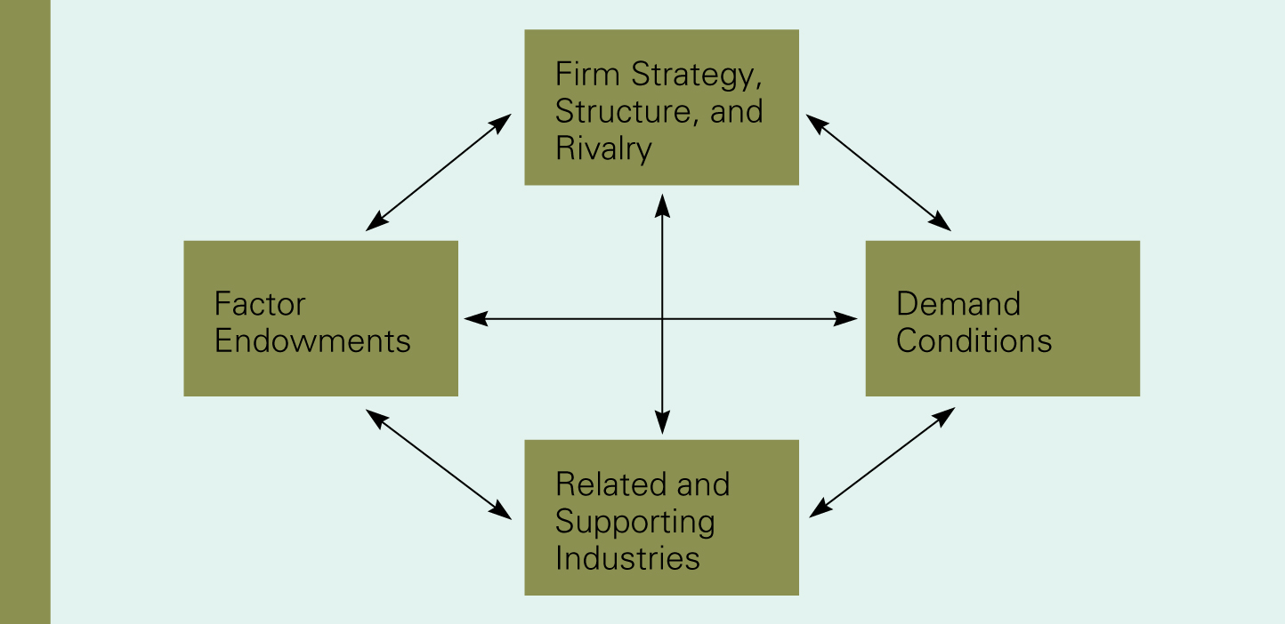
Porter’s diamond
Success occurs where these attributes exist.
More/greater the attribute, the higher chance of success
The diamond is mutually reinforcing

Slide 32
National Competitive
Advantage: Porter’s Diamond
Michael Porter tried to explain why a nation achieves international success in a particular industry and identified four attributes that promote or impede the creation of competitive advantage:
Factor endowments (skilled labor, infrastructure)
Demand conditions (the nature of home demand)
Relating and supporting industries (the presence or absence of supplier industries and related industries that are internationally competitive)
Firm strategy, structure, and rivalry (how companies are created, organized and managed & the nature of domestic rivalry)
Notes:
Why does Japan do so well in the automobile industry? Why do Germany and the United States do so well in the chemical industry?
These four broad attributes of a nation shape the environment in which local firms compete.

Slide 33
Factor Conditions
Factor conditions:- A nation’s position in factors of production such as skilled labor or infrastructure necessary to compete in a given industry.
Basic factor conditions
Advanced factor conditions

Slide 34
Basic factor conditions
Basic factors:
Factors present in a country
  Natural resources
  Climate
  Geographic location
  Demographics
While basic factors can provide an initial advantage they must be supported by advanced factors to maintain success.

Slide 35
Advanced factor conditions
Advanced factors:
Are the result of investment by people, companies, government and are more likely to lead to competitive advantage .
If a country has no basic factors, it must invest in advanced factors.
communications
skilled labor
research
Technology
education

Slide 36

Demand conditions
Demand conditions refer to the nature of home demand for the industry’s product or service that influences the development of capabilities
Sophisticated and demanding customers pressure firms to be competitive, by creating pressures for innovation and quality
E.g. Japanese camera industry; wireless telephone equipment industry of Scandinavia and Sweden

Slide 37
Related and supporting industries
Creates clusters of supporting industries that are internationally competitive.
Suppliers of raw materials, market intermediaries, financial companies, consulting agencies, ancillary industries etc….
Must also meet requirements of other parts of the Diamond

Slide 38
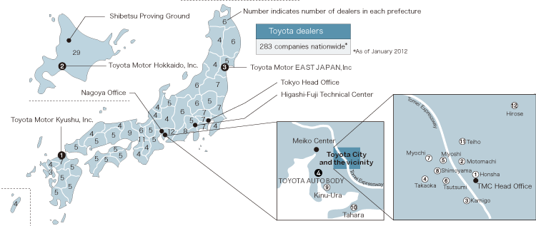
OEMs ( Original Equipment Manufactures) locate their plants Geographically near by Toyota Corporation.( Facilitate JIT-Just In Time system)

Slide 39
Firm Strategy, Structure, And Rivalry
The conditions in the nation governing how companies are created, organized, and managed, and the nature of domestic rivalry impacts firm competitiveness
Different management ideologies affect the development of national competitive advantage.
  E.g. predominance of engineers in top management at German and Japanese firms-improvement in manufacturing processes and product design
  E.g. predominance of finance people in top management at the US firms-overemphasis on maximizing short term financial return
Vigorous domestic rivalry creates pressures to innovate, to improve quality, to reduce costs, and to invest in upgrading advanced features

Slide 40
Balance of Payments
A set of accounts called the country’s Balance Of Payments (BOP) summarizes all the transactions by residents, firms and government of one country with their counterparts in the rest of the world

Slide 41
BOP Accounts:
Current Account
Capital Account
Official Settlements Account

Slide 42
Current Account:
Merchandise Trade
  Exports of Goods ( X_{G} )
  Imports of Goods ( M_{G} )
Services
  Banking, Legal, Shipping, Insurance, Travel, Transportation, Consulting, etc.
Investment Income
Unilateral Transfers

Slide 43
Capital Account:
Long-Term Capital Account:
a. Transactions in Real Assets
b. Transactions in Financial Assets

Slide 44
Official Settlements Account:
Changes in Official Reserves:
a. Official Gold Reserves;
b. Official Foreign Exchange Holdings;
c. Reserve Position in the IMF; and
d. Special Drawing Rights (SDRs)
Changes in Liabilities to Foreign Authorities

Slide 45
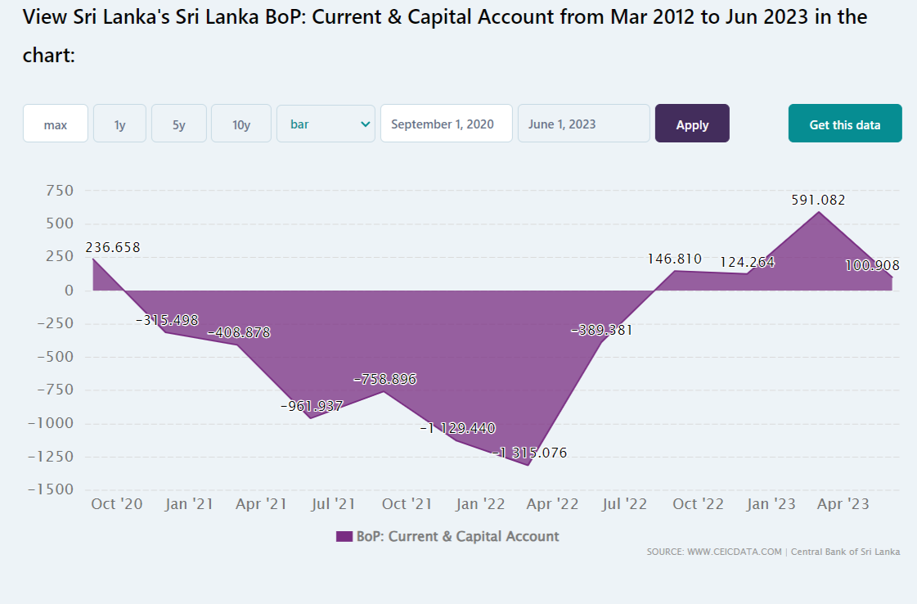

Slide 46
The End

